Slide 1
Matthew 6:9-13 (NIV)
9 "This, then, is how you should pray: " 'Our Father in heaven, hallowed be your name,
10your kingdom come, your will be done on earth as it is in heaven.
11Give us today our daily bread.
12Forgive us our debts, as we also have forgiven our debtors.
13And lead us not into temptation, but deliver us from the evil one. '

Slide 3
Practices of Faith
Praying Like Jesus –
Andy Hodgson

Slide 4
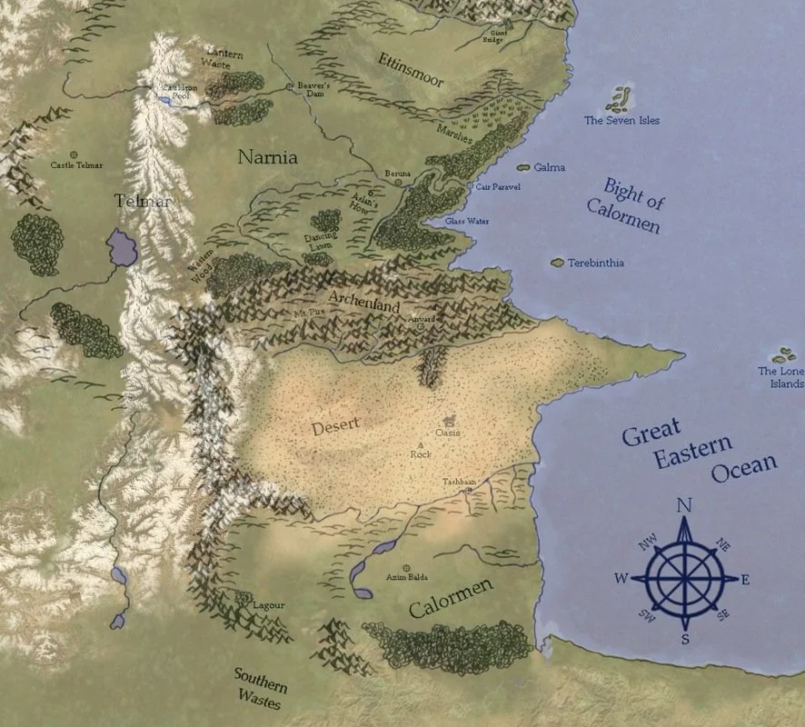
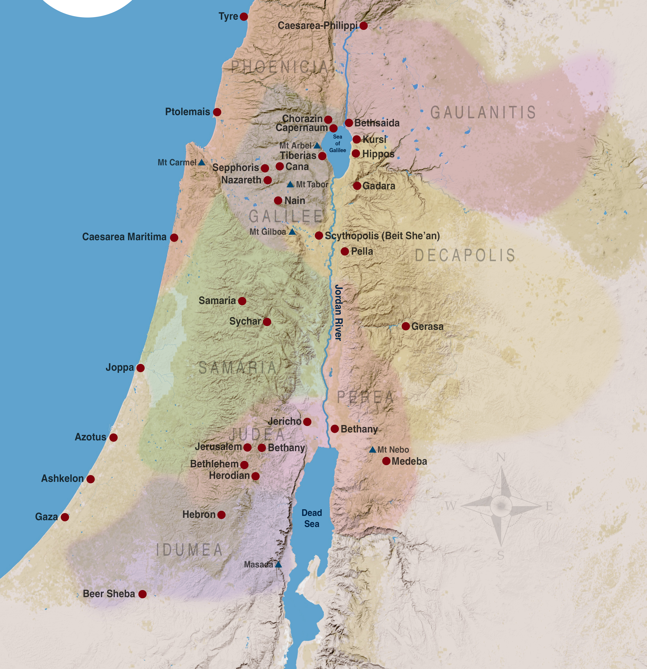

Slide 5
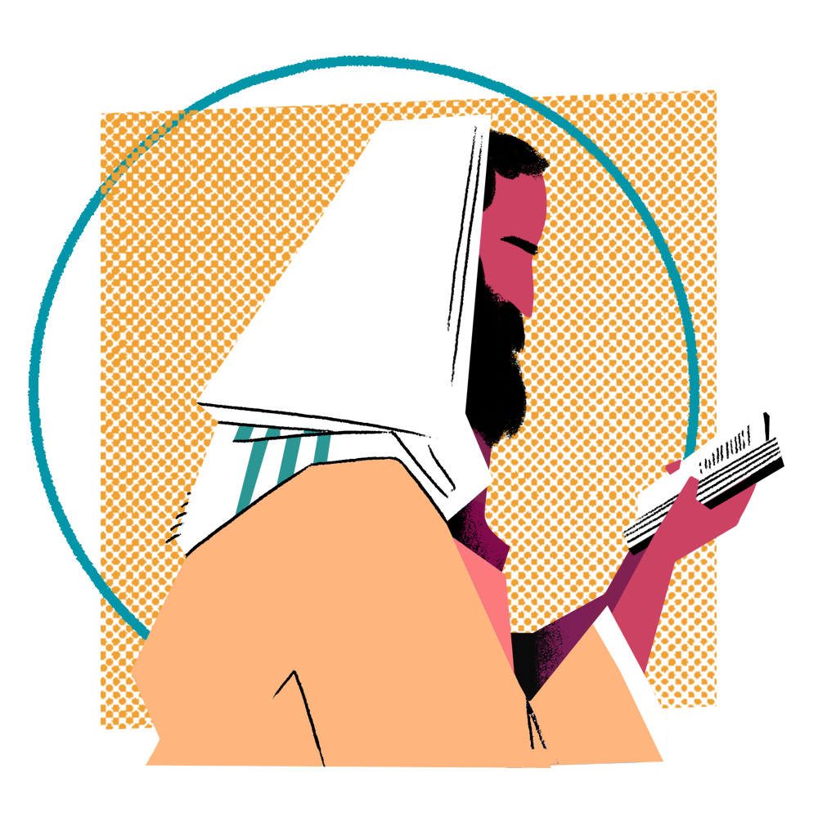
Praying Like Jesus

Slide 6
Praying Like Jesus
“Our Father in heaven,
may your name be kept holy.
May your Kingdom come soon.
May your will be done on earth
as it is in heaven.”

Slide 7
Praying Like Jesus
“Give us today the food we need,
And forgive us our sins
as we forgive those who sin against us.
And don’t let us yield to temptation,
but rescue us from the evil one.”

Slide 8
Praying Like Jesus
Personal Prayer
Gathered Prayer
Community Prayer

Slide 9
Praying Like Jesus
“Our Father in heaven,
may your name be kept holy.
May your Kingdom come soon.
May your will be done on earth
as it is in heaven.”

Slide 10
Praying Like Jesus
“Give us today the food we need,
And forgive us our sins
as we forgive those who sin against us.
And don’t let us yield to temptation,
but rescue us from the evil one.”

Slide 11
Praying Like Jesus

